Slide 1
SUFFRAGETTES
Challenges for Britain, Europe, and the wider world 1901 to the present day
Non-statutory

Slide 2
This was the beginning of a campaign the like of which was never known in England, or for that matter in any other country…..we interrupted a great many meetings……and we were violently thrown out and insulted. Often we were painfully bruised and hurt.
Emmeline Pankhurst in her autobiography

Slide 3
LEARNING OBJECTIVES
KEY WORDS
At the end of the module, students should be able to:
Discuss some of the famous Suffragettes
Assess the actions taken by the Suffragettes in Britain
Evaluate the impact of the Suffrage Movement
Suffragettes
Suffragists
Force feeding
Hunger strike

Slide 4
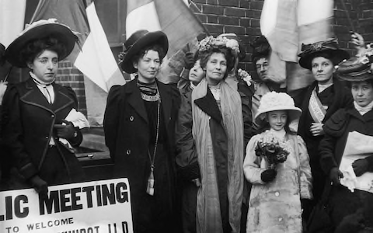
MODULE CONTENT
This module includes the following topics:
Famous Suffragettes
Suffragette actions
Right to suffrage in the world and impact of the movement
Emmeline Pankhurst, founder of the Women's Social and Political Union who fought for women's right to vote, pictured leaving prison with her daughter, Christabel, in 1908
Notes:
Image source: https://www.telegraph.co.uk/women/politics/eight-things-didnt-know-suffragette-movement/

Slide 5
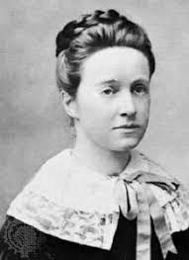
THE SUFFRAGETTES
As early as 1897, women were working to have the right to vote. It was Millicent Fawcett, founder of the National Union of Women’s Suffrage, who believed that peaceful protest could attain such a goal.
MILLICENT FAWCETT
Born on June 11, 1847, in England, Millicent Fawcett served as the leader of suffragette movement in England for 50 years. Aside from being the founder of a women’s union, Fawcett also established the Newnham College, one of the first university colleges for women in England.
Fawcett argued that women should be given the right to take part in the process of lawmaking (though voting) as women obey laws. Among her arguments were the following:
Women pay taxes like men
Women were permitted to hold responsible posts like in school boards
Wealthy women employed laborers who could vote
Image of Millicent Fawcett
Notes:
Image source: https://www.twinkl.ie/illustration/suffragette-protest-votes-women-ks4
https://www.britannica.com/biography/Millicent-Fawcett

Slide 6
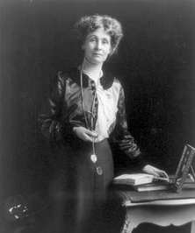
THE SUFFRAGETTES
Amidst Fawcett’s effort in convincing the Parliament, her peaceful process turned slow. As a result, women expressed anger, which gave way to leftist suffragettes.
Suffragettes were women who sought the right to vote in public elections.
EMMELINE PANKHURST
Born on July 14, 1858, in Manchester, England, Emmeline Pankhurst founded the Women’s Social and Political Union, along with her daughters Christabel and Sylvia.
Unlike Fawcett, Pankhurst, along with members of the union that became known as Suffragettes, believed that women should have the right to vote even if it means violence.
In 1905, Pankhurst and Annie Kenney interrupted Winston Churchill and Sir Edward Grey in their political meeting in Manchester. As a result, they were thrown out and arrested for assaulting a police officer.
Image of Emmeline Pankhurst

Slide 7
GUIDE QUESTION
After learning about the pioneers of the Suffrage Movement in Great Britain, take note of the following questions:
Who were Millicent Fawcett and Emmeline Pankhurst?
How did their advocacies differ?
What were the impacts of both women in the movement?
ACTIVITY
Compare and contrast the advocacies and actions of Suffragettes Millicent Fawcett and Emmeline Pankhurst.
MILLICENT FAWCETT
EMMELINE PANKHURST

Slide 8
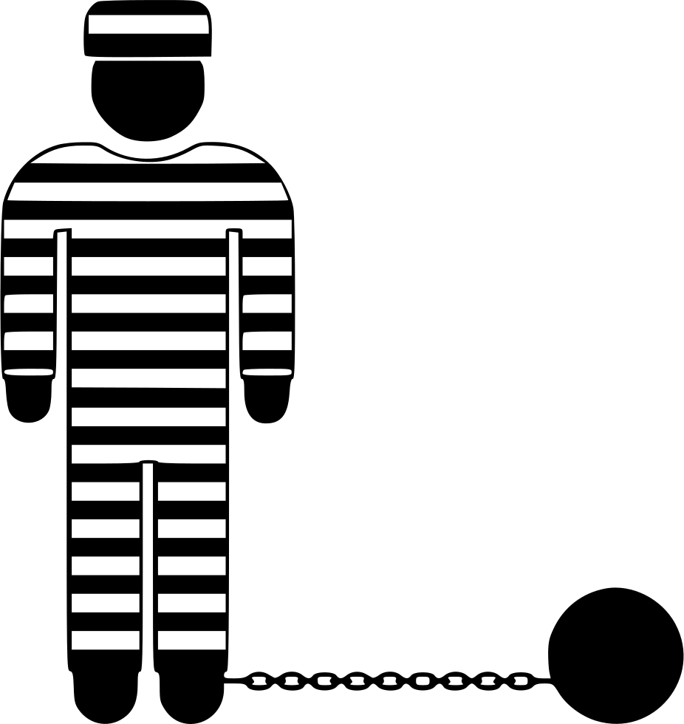
SUFFRAGETTE ACTIONS
In order to be heard, the Suffragettes engaged in a series of actions, including the following:
Some chained themselves to Buckingham Palace to show the Royal Family their cause.
Women embraced going to prison. From there, they went on hunger strikes. In response, prison governors ordered force feeding to prevent women from dying in prison. This act was used by Suffragettes to gain public attention as they were mostly educated women.
Churches were burned down, as the church of England opposed the idea of granting women the right to vote.
They broke down windows and vandalised Oxford Street. The Suffragettes attacked golf courses and houses of politicians.
In order to avoid force feeding Suffragettes in prison, the government of Asquith passed the Cat and Mouse Act. This act let Suffragettes go on hunger strikes. They were released from prison as they became weak.
OXFORD

Slide 9
GUIDE QUESTION
After learning the actions taken by the Suffragettes, take note of the following questions:
Do you agree with the idea of hunger strikes? Why do you think they had to do such an act?
Are you a constitutionalist or a militant? Explain why.
ACTIVITY
Collect real pictures available online and make a collage of some of the actions taken by the Suffragettes. Afterwards, explain your thoughts about the pictures.
INSERT COLLAGE HERE

Slide 10
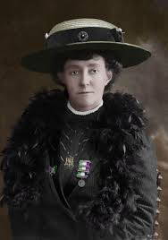
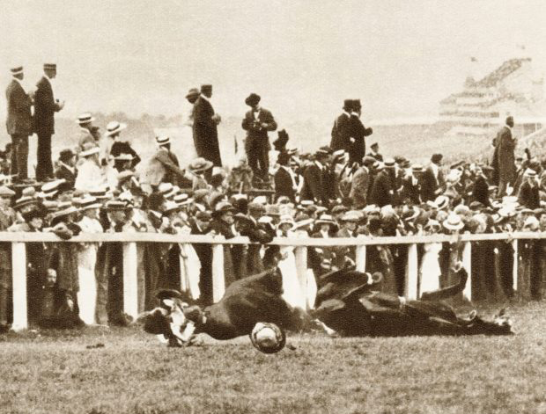
EMILY DAVISON: A MARTYR?
EMILY DAVISON
Born on October 11, 1872, in Blackheath, London, Emily Davison was an educated woman who studied at Royal Holloway College and Oxford University. In 1906, she became a member of the Women’s Social and Political Union and became a full time Suffragette after three years. In 1909, after throwing rocks on the carriage of Chancellor Lloyd George, Davison was arrested and sentenced to hard labour for a month.
Image of Emily Davison
Image of Emily Davison as she threw herself in front of King George V’s horse
In prison, like other Suffragettes, Davison attempted to starve herself. She was then force-fed by a prison guard. Upon her release she sued the wardens and was granted with 40 shillings. On June 4, 1913, Davison went extreme and threw herself in front of King George V’s horse at the Epsom Derby. Four
days later she died of her injuries and became the first martyr of the Suffragettes.
Notes:
Image source: https://www.thesun.co.uk/living/3754943/emily-davison-died-exactly-104-years-ago-today-fighting-for-womens-right-to-vote-heres-her-incredible-story/

Slide 11
WOMEN SUFFRAGE AROUND THE WORLD
After long perseverance of American Suffragists, the 19th Amendment granted women the right to vote on August 26, 1920.
In 1918, women over the age of 30 were given the right to suffrage and in 1928 voting rights for men and women were the same.
Also known as the Suffragists, women in the United States first sought the right to vote in 1848, during the Seneca Falls Convention. At first, there were two groups of Suffragists, one led by Susan B. Anthony and Elizabeth Cady Stanton (National Woman Suffrage), the other by Lucy Stone (American Woman Suffrage Association). The two merged in 1890 as the National American Woman Suffrage Association.
Other European countries such as Finland, Norway, Denmark, and Iceland soon followed.
In 1893, women in New Zealand were granted the right to suffrage on the national level.
After WWI, the USSR, the Netherlands, Poland, Sweden, Austria, and Germany granted women the right to vote.
Australia followed in 1902.

Slide 12
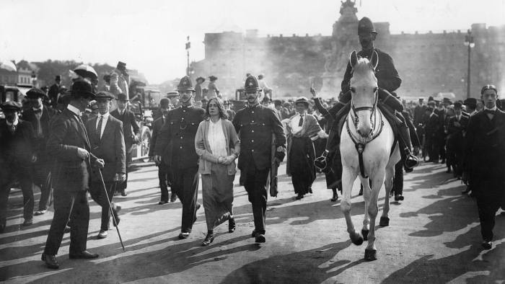
IMPACT OF WOMEN SUFFRAGE
The success of the Suffragette movement in Britain did not only grant women the right to participate in the elections, but also expanded women’s political and economic affiliations. With such development, changing attitudes to marriage and family emerged. Furthermore, it set the stage for new movements such as vegetarianism, religious nonconformism, and pacifism.
Suffragists were constitutionalists who went under the colours red, green, and white, while the Suffragettes were known militants with colours purple, green, and white.
Police lead away Suffragettes, arrested for chaining themselves to the railings of Buckingham Palace in 1914
Notes:
Image source: https://www.ft.com/content/22776930-05f6-11e8-9e12-af73e8db3c71

Slide 13
GUIDE QUESTION
After learning about the impact of the women's suffrage movement, take note of the following questions:
How significant was the act taken by Emily Davison?
What was the impact of the Suffragette’s success?
ACTIVITY
Do additional research for this activity as necessary. Write a comparative essay on the Suffragist Movement in the USA and Suffragette Movement in Great Britain. Highlight their advocacies, actions taken, and results.

Slide 14
SUPPLEMENTARY ACTIVITY
Complete the album with pictures and descriptions of some of the most famous Suffragettes.
Write a position paper regarding the importance of women gaining the right to vote.

