Slide 1
Section A of exam
THE FACTS:
4 QUESTIONS
ALL MULTIPLE CHOICE QUESTIONS
WORTH 4 MARKS IN TOTAL
TIME ALLOCATION IN EXAM: 5 MINUTES

Slide 2
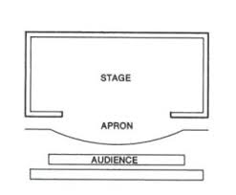
What type of stage is this?
traverse
thrust
In the round
End on / proscenium

Slide 3
What type of stage is this?
End on / proscenium
positives | considerations
The actors can enter / exit easily | Think about facing the audience
Can have still moments | Project voice
No need to change set / extravagant ( could be) | Be aware of sightline

Slide 4
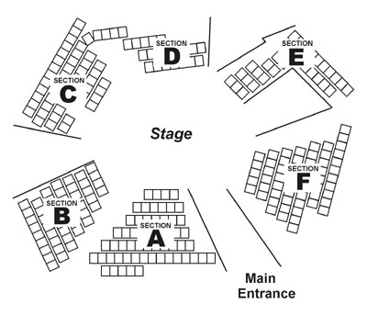
traverse
In the round
thrust

Slide 5
positives | considerations
Audience are immersed / involved | Consider set / minimalistic
See everything / clear view | Be aware of the space and what can/can’t be seen

Slide 6
USR - Upstage Right | USC - Upstage Centre | USL - Upstage Left
CR- Centre Right | CS - Centre Stage | CL - Centre Left
DSR - Downstage Right | DSC - Downstage Centre | DSL - Downstage Left
Audience

Slide 7
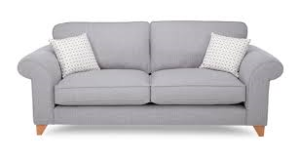


Where is the:
Plant
Rug
Door
sofa

Slide 8

Welcome…

Slide 9
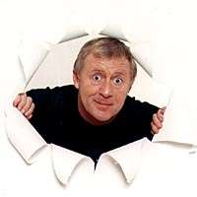
Good Luck!

Slide 10

50/50
Audience
For £100
Who is in charge of designing the puppets for a production?
B: puppet designer
A: the local GCSE kids
C: no-one –why bother with puppets?
D: the prop master

Slide 11
50/50
Audience
For £200
Who is responsible for the rehearsal organisation?
A: lead actor
B: stage manager
C: theatre manager
D: director

Slide 12
50/50
Audience
For £400
What else might you hear the costume department called?
A:wardrobe
B: part timers
C: clothing department
D: Dressers

Slide 13
50/50
Audience
For £1000
Who learns lines in case an actor is unable to perform?
A: their mum
B: stage manager
C: understudy
D: the director

Slide 14
50/50
Audience
For £2000
Who is in charger of creating the sound fx and sound plot / cue sheet?
A: technicians
B:sound designer
C: theatre manager
D: lighting designer

Slide 15
50/50
Audience
For £4000
Where does the audience sit in a proscenium theatre space?
A: in comfy chairs
B: on one side of the stage ( the front)
C: depends where they bought their ticket
D: on three sides

Slide 16
50/50
Audience
For £8000
Who has the initial creative ideas for a performance?
A: the theatre manager
B: the playwright
C: the prop designer
D: director

Slide 17
50/50
Audience
For £16,000
Which stage type?
Audience sat all around with an entrance / exit for actors
A: thrust
B: traverse
D: end on
C: in the round

Slide 18
50/50
Audience
For £32,000
In charge of setting up technical equipment such as microphones or rigging lights before a production or operating technical equipment during a performance.
A: apprentice
B:technician
C: work experience kid
D: stage manager

Slide 19
50/50
Audience
For £64,000
Stage type with audience on two sides of the stage and a long catwalk
A: traverse
B: in the round
C: thrust
D: promenade

Slide 20

50/50
Audience
Stage position of the plant?
For £125,000
A: upstage right
B: downstage right
C: on the stage?
D: downstage left

Slide 21
50/50
Audience
For £250,000
The person who is responsible for and manages the front-of- house team who deal with the audience during the production
A: Theatre manager
B: stage manager
C: understudy
D: ushers

Slide 22
50/50
Audience
For £500,000
This is the name given to the person who writes the play
A: Playwright
B: William Shakespeare
C: performer
D: The clever person

Slide 23
50/50
Audience
For £1,000,000
They will work closely with the director and other designers so that there is unity between all the designs and the needs of the performance
A: performer
B: Set designer
C: puppet designer
D: theatre manager

Slide 24
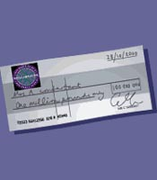
Congratulations!

Slide 25
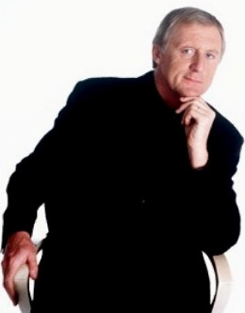

Phone a Friend
Hello, It’s Chris Tarrant here from Who wants to be a millionaire……

Slide 26
Ask the Audience
Okay Audience, Let’s vote.
Hands Ready!

Slide 27
Is that your final answer?
OH! I’m sorry that’s wrong!

