Slide 1
Section A of exam
THE FACTS:
4 QUESTIONS
ALL MULTIPLE CHOICE QUESTIONS
WORTH 4 MARKS IN TOTAL
TIME ALLOCATION IN EXAM: 5 MINUTES

Slide 2
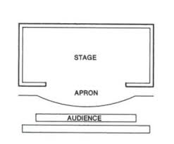
What type of stage is this?
traverse
thrust
In the round
End on / proscenium

Slide 3
What type of stage is this?
End on / proscenium
positives | considerations
The actors can enter / exit easily | Think about facing the audience
Can have still moments | Project voice
No need to change set / extravagant ( could be) | Be aware of sightline

Slide 4
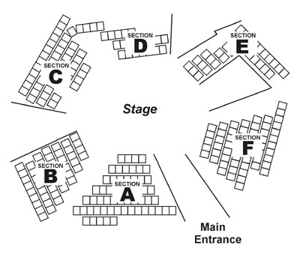
traverse
In the round
thrust

Slide 5
positives | considerations
Audience are immersed / involved | Consider set / minimalistic
See everything / clear view | Be aware of the space and what can/can’t be seen

Slide 6
USR - Upstage Right | USC - Upstage Centre | USL - Upstage Left
CR- Centre Right | CS - Centre Stage | CL - Centre Left
DSR - Downstage Right | DSC - Downstage Centre | DSL - Downstage Left
Audience

Slide 7
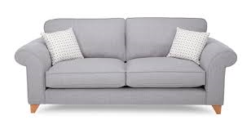
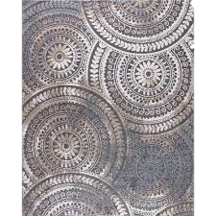
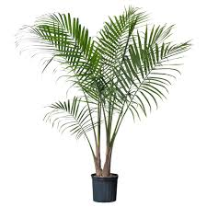
Where is the:
Plant
Rug
Door
sofa

Slide 8

Welcome…

Slide 9
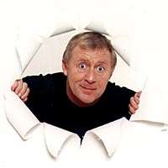
Good Luck!

Slide 10

50/50
Audience
For £100
Who wrote the play ‘Blood Brothers’?
A: Willy Bushell
B: Willy Russell
C: Willy Knowall
D: William Hushup

Slide 11
50/50
Audience
For £200
Where is the play ‘Blood Brothers’ set?
A: Manchester
B: Liverpool
C: London
D: Leicester

Slide 12
50/50
Audience
For £400
Who sang ‘That Guy’?
A: Mickey
and Edward
B: Linda
C: Edward
and Linda
D: Mr Lyons

Slide 13
50/50
Audience
For £1000
Who did Mickey, Linda and Edward shoot at in the park?
A: The Policeman
B: Captain Hook
C: Peter Pan
D: Tinkerbell

Slide 14
50/50
Audience
For £2000
What did Mrs Johnstone call her first child?
A: Darren Blayne
B: Darren Wayne
C: Anthony Shane
D: John Wayne

Slide 15
50/50
Audience
For £4000
What is Mrs Lyons’ first name?
A: Mary
B: Jen
C: Julie
D: Shirley

Slide 16
50/50
Audience
For £8000
What is Mr Lyons’ first name ?
A: Robert
B: James
C: Rufus
D: Richard

Slide 17
50/50
Audience
For £16,000
How much did Sammy offer Mickey for keeping ‘the eye out’?
A: £100
B: £30
D: £20
C: £50

Slide 18
50/50
Audience
For £32,000
Which university does Edward want to go to?
A: Cambridge
B: Oxbridge
C: Oxford
D: Camford

Slide 19
50/50
Audience
For £64,000
Name the lady who owns the chippy.
A: Mrs Wong
B: Mrs Yinkam
C: Mrs Wok
D: Mrs Curry

Slide 20
50/50
Audience
For £125,000
What films do the twins go to see?
A: ‘Tennis with tits’
and ‘Sex, sex, sex’
B: ‘Bertha’s breasts’
and ‘John’s Bigun’
D: ‘Nymphomaniac Nights’ and ‘Swedish Au Pairs’
C:’Dr. Zhivago’ and ‘The Magnificent 7’

Slide 21
50/50
Audience
For £250,000
Name Mrs Johnstone’s daughter
A: Donna Marie
B: Donna Osmand
C: Donna Claire
D: Donna Mary

Slide 22
50/50
Audience
For £500,000
What address did the Johnstones move to?
A: 65 Skelmersdale Lane
B: 65 Skelmersdale Rd
C: 69 Skelmersdale Ave
D: 69 Skelmersdale Close

Slide 23
50/50
Audience
For £1,000,000
Name the milkman in Act Two
A: Jim
B: Joe
C: Jon
D: Josh

Slide 24
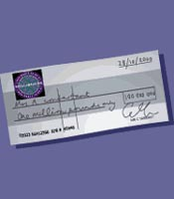
Congratulations!

Slide 25
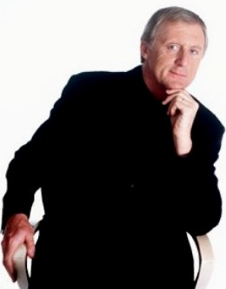

Phone a Friend
Hello, It’s Chris Tarrant here from Who wants to be a millionaire……

Slide 26
Ask the Audience
Okay Audience, Let’s vote.
Hands Ready!

Slide 27
Is that your final answer?
OH! I’m sorry that’s wrong!

