Slide 1
Wednesday – Graphics, Food, RE, Sociology

Slide 2
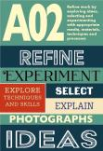
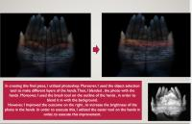
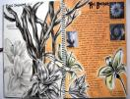
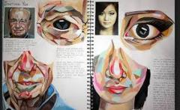
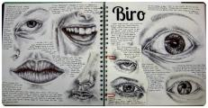
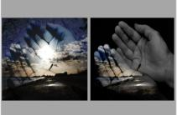
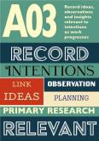
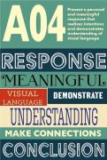
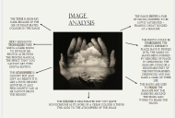
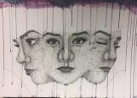
The Creative Arts and Technology department will be offering: Fine Art, Photography, Art Textiles, Graphics and Food Preparation and Nutrition
All of the Art options will provide you with a chance to explore and develop your creativity in a personal way! Each course is tailored towards delivering different techniques/skills to give you the opportunity that can lead you onto a path to a creative career that suits you!
All four Art based GCSE courses are made up of
Component 1- Personal portfolio (Coursework)- 60%- 1 main project and 1 side
Component 2- Externally set assignemt-40%
10 hour controlled assessment (project chosen by you)
Each course will require at least an hour a week of homework

Slide 3
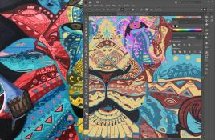
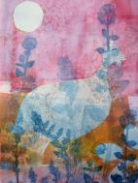
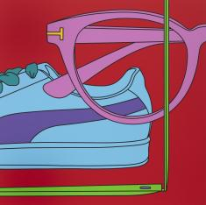
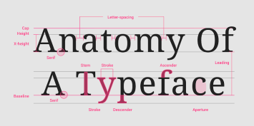
Graphics Digital manipulation of designs, typography, digital drawing, print making
The demand for digital design continues to grow as businesses increasingly move online and seek professional design services for websites, apps, advertisements, and branding
Graphic Designer, Freelance and/or Employed
Advertising Art Director
Animator
Illustrator
Printmaker
Design and Marketing Manager
Web Designer

Slide 4
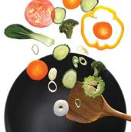
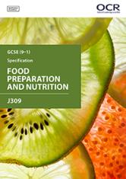
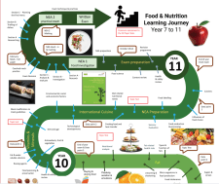
Food Preparation and Nutrition Topics-Nutrition, Food production, Food Science, Cooking Methods
Non Assessed examination 1 (worth 15%)- This is a science based investigation into a theme provided by OCR- the investigation will be concluded with a practical experiment e.g. different rising agents in foods
Non Assessed examination 2 (worth 35%)- Pupils are provided with a theme e.g. protein in foods. They complete a 20 page research project investigating the theme and planning a 3 course menu based on the research- this menu takes into account nutrients, timings and cost. In a 3 hour controlled assessment pupils are then expected to make their menu
Written Examination (worth 50%)- This exam will be taken at the end of the course and will assess all of the knowledge from the topics listed above
Careers
Public Health
Clinical Nutrition/Dietetics
Food/Industry
Academia, Research and Lecturing
Teaching
Sports and Exercise Nutrition
Animal Nutrition
Catering industry

Slide 5
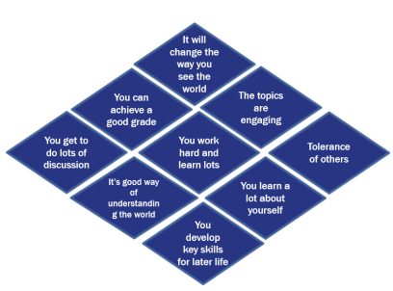
What will I study?
Component 2: Thematic studies
4 Religious, philosophical and ethical studies
A: Relationships and families.
B: Religion and life.
D: Religion, peace and conflict.
E: Religion, crime & punishment
Component 1: Religions
Beliefs, teachings and practices of two religions:
Christianity
Islam
Why choose GCSE RE?
What careers does it link to?

Slide 6
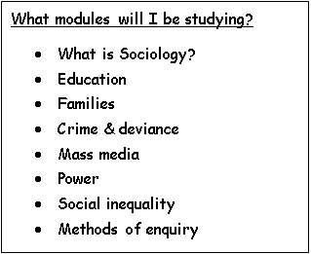
New for 2025!
What is sociology?
These are the kind of questions that you will look at in Sociology:
• Are all ‘hoodies’ hooligans?
•Why are young black people eight times more likely to be stopped and searched than white people?
•Why do girls do better at school than boys?
•What is gang culture?
•What does it mean to be poor in Britain today?
Sociology studies how society works. It helps you to understand how individuals fit into a wider social network and encourage you to question beliefs about society
Sociologists are interested in why society works in the way that it does and the extent to which our behaviour and opportunities can be shaped by our social class, age, gender and race.
What careers does it link to?
Social work/services
Community projects
Journalism
Prison officers
Police

